Slide 1
“Once You Start ‘Em, How Do You Keep ‘Em?
Starting and retaining beginning bass players
Michael Trowbridge, Retired Orchestra Director
Notes:
----- Meeting Notes (11/22/19 20:00) -----

Slide 2
Contact info:
Down load Power Point file of this session and notes from:
Web: mtrowmusic.com
Email: mtrowbridgebass@gmail.com

Slide 3
“Bassic” Bass Playing Position
The right height
“Corner in the belly”
Touch your nose
“Hug” the bass
Slow dancing
Notes:
----- Meeting Notes (11/22/19 20:00) -----

Slide 4
Pizzicato
Thumb on the side of the finger board
Side of the index finger
“In addition to regular pizzicato, students can
learn a “rest stroke” (classical guitar term) or jazz pizzicato. Use the side of the finger and then have the finger rest on the adjacent lower string after playing the note. The sound will be much louder and there will be fewer blisters on the finger.” (From Measures of Success for String Orchestra – Teachers Manual)
From “Measures of Success for String Orchestra – Teachers Manual - FJH

Slide 5
Left Hand Position
Thumb opposite 2nd finger
Fingers curved, not collapsed
Throwing a football
Straight wrist
Elbow up – (at a right angle with the neck)
Left hand spacing ½ step between 1st and 2nd finger
Whole step between 1st and 4th

Slide 6
Example of left hand setup.
From “Measures of Success for String Orchestra” bass book - FJH Publisher

Slide 7
Holding the bow
Over Hand - French
  Thumb curved
  Relaxed right hand
  Flexible fingers
Under Hand - German
  Three fingers meet at one point
  Pinky rests on bottom of ferule
  Flexible fingers

Slide 8
More on bow holds
  For both styles of bow holds:
  Start with a pencil
  Practice bow hold with out the bass
  Left hand helps
  Instrument helps

Slide 9
Description of French bow hold.
From “Measures of Success for String Orchestra” bass book - FJH Publisher
From

Slide 10
Description of German bow hold
From “Measures of Success for String Orchestra” bass book - FJH Publisher

Slide 11
Rosin
  Pops
  Nyman
  Carlsson
  Lemurmusic.com
  Rosin on the bow?
  Too much rosin?
  Clean that instrument!

Slide 12
“Bassic” bowing
Right angle
Arm weight
String vibrating
Big instrument
High = faster
Low = slower
Length of the string

Slide 13
Shifting? – There will be shifting!
Thumb moves with hand
Relaxed
Keep in touch
No hopping
Muscle memory
More than the D scale
Get out of 1st position

Slide 14
Better Musicianship only a ½ step away
Between 1st and 3rd
F# to G
Cross over
Yes… Get out of 1st position

Slide 15
Examples of II position on D string
From “Measures of Success for String Orchestra” bass book - FJH Publisher

Slide 16
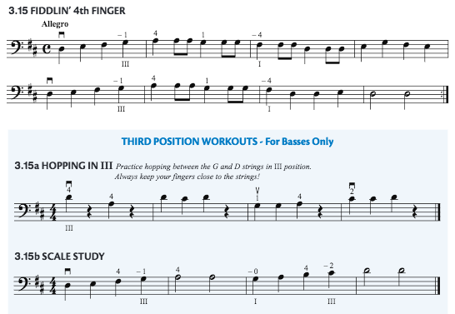
Examples of III position on the D string

Slide 17
Where to put those things?
Not in the back of the room!
Front and center!
Special attention
Within arms’ reach
Eye contact
Have faith in the basses

Slide 18
Contact info:
Down load Power Point file of this session and notes from:
Web: mtrowmusic.com
Email: mtrowbridgebass@gmail.com

